Slide 1
F/P Isolation Method
Richard Doty

Slide 2
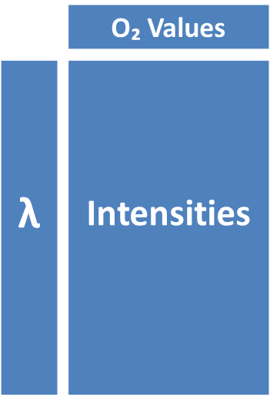
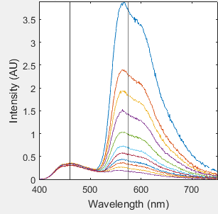
Setup
Example Data Set : CD_i_3OC12_Phen_PLAPEG
Wavelengths : 400 –> 750 ( 351 rows x 1 column)
O₂ Values : [ 0 , 1 , 3 , 5 , 8.9 , 15.4 , 21 , 29.7 , 40.37 , 67.18 , 100 ] ( 1 row x 11 columns)
Intensities : [ Varies ] ( 351 rows x 11 columns)
Selected F and P Wavelengths : [ 460 , 575 ] ( 2 rows x 1 column)

Slide 3
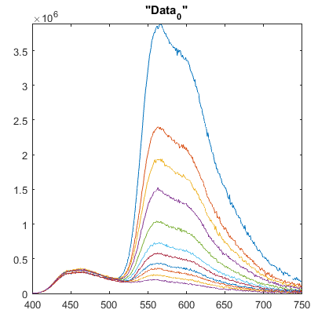
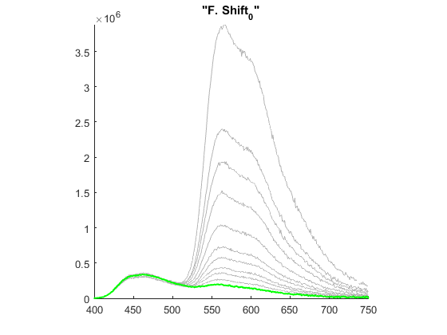
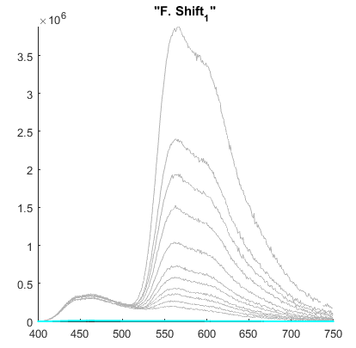
Step 1
Take the most quenched sample from the original data ( or “Data₀” ) and call it “F. Shift₀”
Scale “F. Shift₀” so it is ≤ all the other samples in “Data₀” at all wavelengths
Call this scaled version “F. Shift₁”
“Data₀”
“F. Shift₀”
“F. Shift₁”

Slide 4
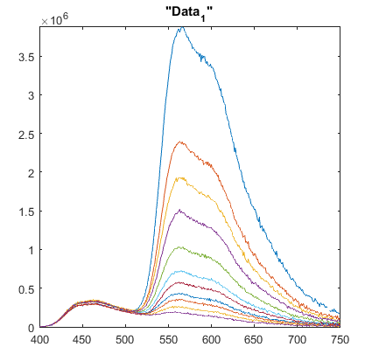
Step 2
Subtract “F. Shift₁” from “Data₀” to create “Data₁”
“Data₀”
“Data₁”

Slide 5
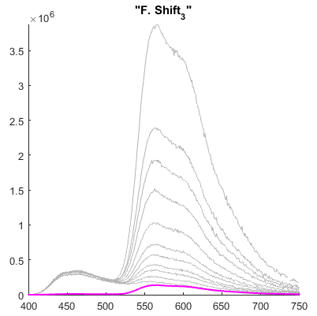
Step 3
Take the LEAST quenched sample from “Data₁” and multiply it by the scalar and call this curve “F. Shift₃”
“Data₁”
“F. Shift₃”

Slide 6
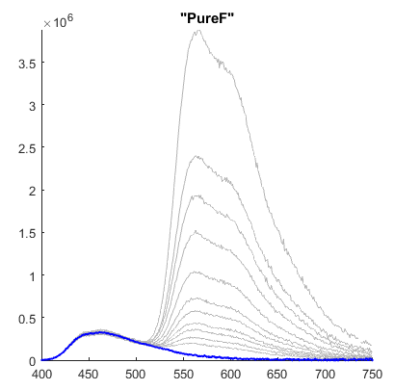
Step 4
Subtract “F. Shift₃” from “F. Shift₀” and this is the isolated fluorescence or “PureF”

Slide 7
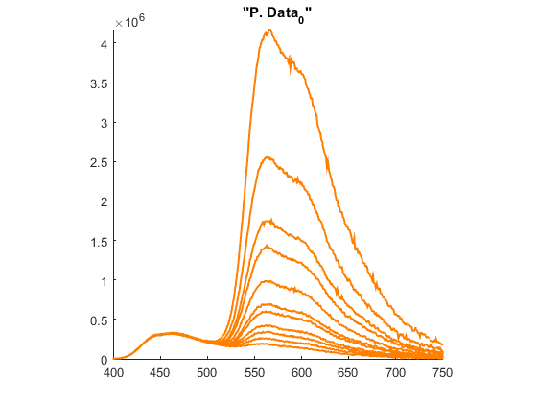
Step 5
Scale “Data₀” so it is equal to “PureF” at the selected fluorescence wavelength and call this “PData₀”

Slide 8
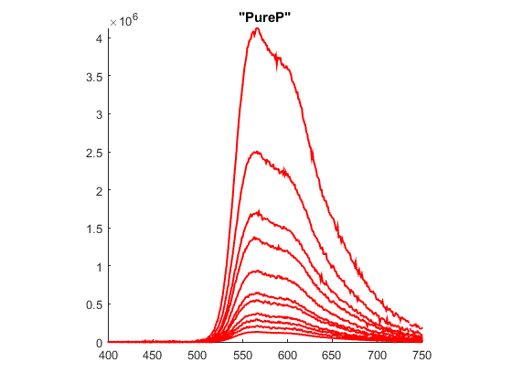
Step 6
Subtract “PureF” from “PData₀” to get “PureP”

Slide 9
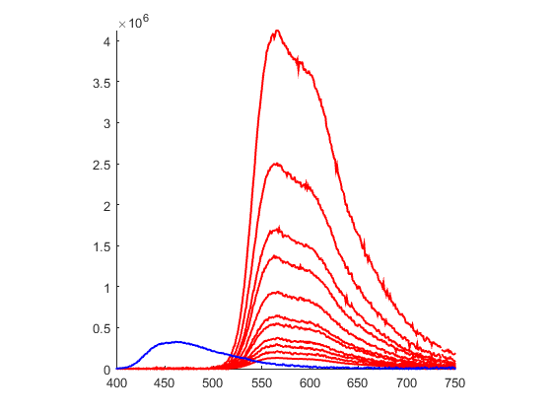
Complete

